Slide 1
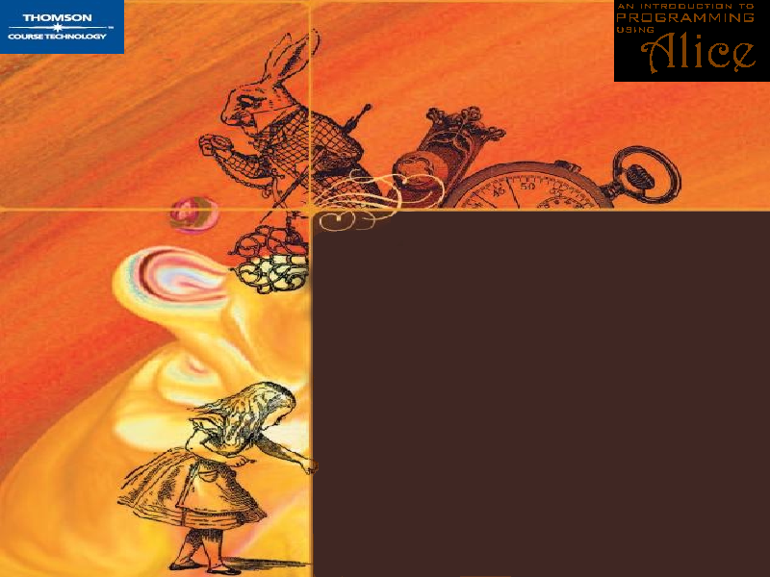
Object-Oriented
Programming
An Introduction to Programming Using Alice

Slide 2
Object-Oriented Programming
An algorithm is a step-by-step process.
A computer program is a step-by-step set of instructions for a computer.
Every computer program is an algorithm.
Algorithms have a long history in science, technology, engineering and math.
An Introduction to Programming Using Alice

Slide 3
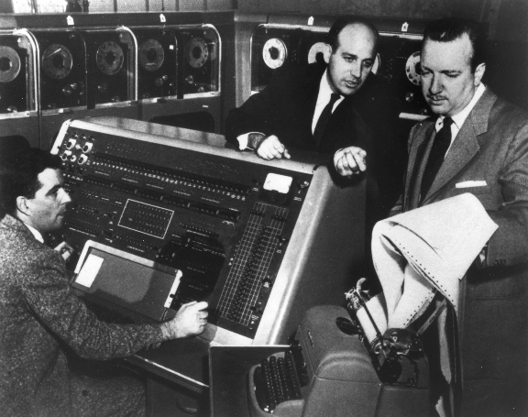
Object-Oriented Programming
Early computers were
far less complex than computers are today.
Their memories were smaller and their programs were much simpler.
An Introduction to Programming Using Alice

Slide 4
Object-Oriented Programming
They usually executed only one program at a time.
An Introduction to Programming Using Alice

Slide 5

Object-Oriented Programming
Modern computers are smaller, but far more complex than early computers.
The can execute many programs at the same time.
An Introduction to Programming Using Alice

Slide 6
Object-Oriented Programming
Computer scientists have introduced the notion of objects and object-oriented programming to help manage the growing complexity of modern computers.
An Introduction to Programming Using Alice

Slide 7
Object-Oriented Programming
An object is anything that can be represented by data in a computer’s memory and manipulated by a computer program.
An Introduction to Programming Using Alice

Slide 8

Object-Oriented Programming
An object is anything that can be represented by data in a computer’s memory and manipulated by a computer program.
Numbers
An Introduction to Programming Using Alice

Slide 9

Object-Oriented Programming
An object is anything that can be represented by data in a computer’s memory and manipulated by a computer program.
Text
An Introduction to Programming Using Alice

Slide 10

Object-Oriented Programming
An object is anything that can be represented by data in a computer’s memory and manipulated by a computer program.
Pictures
An Introduction to Programming Using Alice

Slide 11

Object-Oriented Programming
An object is anything that can be represented by data in a computer’s memory and manipulated by a computer program.
Sound
An Introduction to Programming Using Alice

Slide 12

Object-Oriented Programming
An object is anything that can be represented by data in a computer’s memory and manipulated by a computer program.
Video
An Introduction to Programming Using Alice

Slide 13

Object-Oriented Programming
An object is anything that can be represented by data.
An Introduction to Programming Using Alice

Slide 14

Object-Oriented Programming
An object can be something in the physical world or even just an abstract idea.
An airplane, for example, is a physical object that can be manipulated by a computer.
An Introduction to Programming Using Alice

Slide 15

Object-Oriented Programming
An object can be something in the physical world or even just an abstract idea.
A bank transaction is an example of an object that
is not physical.
An Introduction to Programming Using Alice

Slide 16
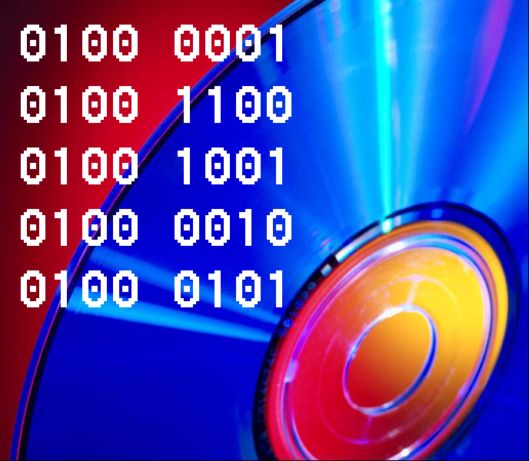
Object-Oriented Programming
To a computer, an object is simply something that can be represented by data in the computer’s memory and manipulated by computer programs.
An Introduction to Programming Using Alice

Slide 17
Object-Oriented Programming
The data that represent the object are organized into a set of properties.
The values stored in an object’s properties at any one time form the state
of an object.
Name: PA 3794
Owner: US Airlines
Location: 39 52′ 06″ N 75 13′ 52″ W
Heading: 271°
Altitude: 19 m
AirSpeed: 0
Make: Boeing
Model: 737
Weight: 32,820 kg
An Introduction to Programming Using Alice

Slide 18
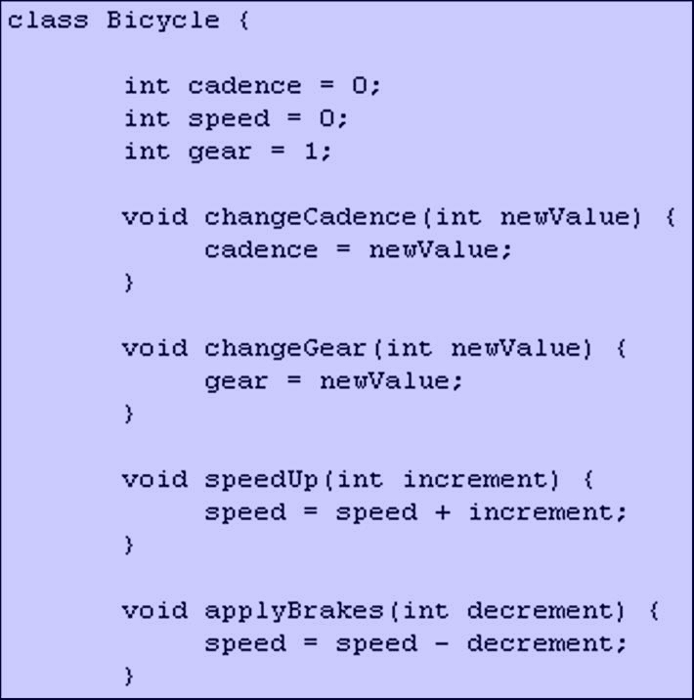
Object-Oriented Programming
Computer programs implement algorithms that manipulate the data.
In object-oriented programming, the programs that manipulate the properties of an object are the object’s methods.
An Introduction to Programming Using Alice

Slide 19
Object-Oriented Programming
We can think of an object as a collection of properties and the methods that are used to manipulate those properties.
Properties
Methods
An Introduction to Programming Using Alice

Slide 20
Object-Oriented Programming
A class is a group of objects with the same properties and the same methods.
An Introduction to Programming Using Alice

Slide 21

Object-Oriented Programming
Each copy of an object from a particular class is called an instance of the object.
An Introduction to Programming Using Alice

Slide 22

Object-Oriented Programming
The act of creating a new instance of an object is called instantiation.
An Introduction to Programming Using Alice

Slide 23
Object-Oriented Programming
A class can be thought of as a blueprint for instances of an object.
An Introduction to Programming Using Alice

Slide 24
Object-Oriented Programming
Two different instances of the same class will have the same properties, but different values stored in those properties.
An Introduction to Programming Using Alice

Slide 25
Object-Oriented Programming
Object
Property
The same terminology is used in most object-oriented programming languages.
Instantiation
Method
Class
Instance
State
An Introduction to Programming Using Alice

